Slide 1
Data Science <Case Study>
Paper Ⅰ. Using “Twitter” Data in
Real-Time Disease Surveillance on Flu and Cancer
Sang-woo Park / Woo-Jin Shim

Slide 2
Contents
Intro.
Abstract – um, ...
Main Subject
Process - how, ...
Effect - what, ...
Conc.
Result & Prospect - so, ...

Slide 3
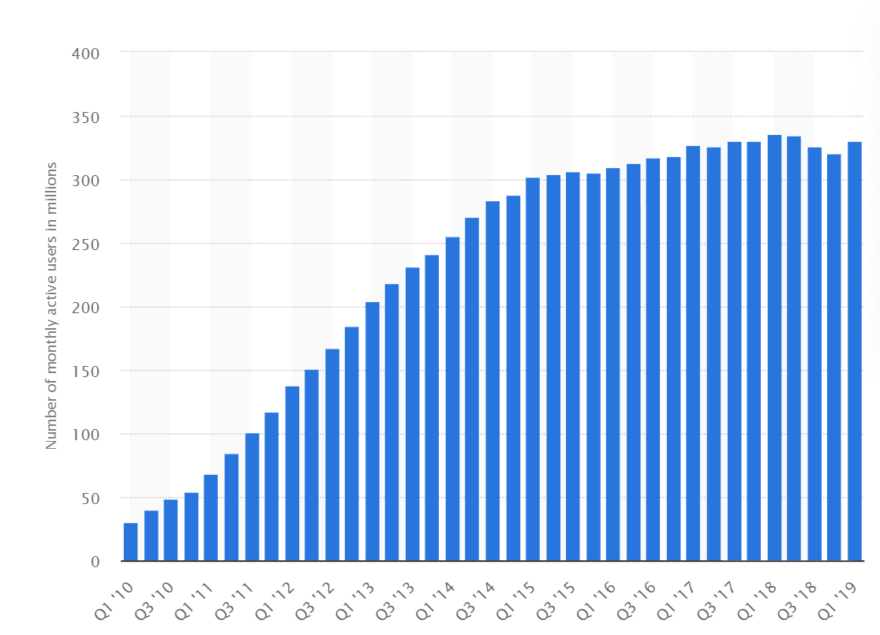
Intro.
Ⅰ. Abstract – um, ...
Importance in real-time disease surveillance
- prevent outbreak / spreading, handle quickly
SNS(Twitter) sometimes change to data gathering place
about disease, such as symptom, treatment, side-effect.
Numerous valuable data is hidden under the
Twitter’s database from huge user group’s posting
Big data analyzing
- extract a value from ‘Huge’ and ‘Numerous’ data set
<Worldwide User of Twitter>
chart source : https://www.statista.com/statistics/282087/number-of-monthly-active-twitter-users/

Slide 4
Main Subject
Ⅰ. Process – how, ...
Geographical Analysis
Purpose : Surveillance of disease’s (about flu and cancer)
spreading / distribution in Real-Time
Method
Collect tweets which mention ‘flu’ or ‘cancer’.
Exclude tweets from outside the US or having invalid location info.
Count how many word related to ‘flu’ or ‘cancer’ with its location data.

Slide 5
Main Subject
Ⅰ. Process – how, ...
Temporal Analysis
Purpose : Track the volume changes of tweets mentioning the disease
- about flu - with times pass.
Method (i) - about Disease Daily Activity Timeline
Make a timeline by gathering tweets generated daily
Accumulate timelines for three months; during January ~ March 2013
Compare with CDC’s ILI(Influenza-like Illness) and news reports

Slide 6
Main Subject
Ⅰ. Process – how, ...
Temporal Analysis
Purpose : Track the volume changes of tweets mentioning the disease
- about flu - with times pass.
Method (ii) - about Types, Symptoms, Treatments Timeline
Make a timeline about each different types, symptoms, and treatments of flu by gathering tweets generated daily
Accumulate timelines for three months; during January ~ March 2013
Compare with CDC’s ILI and news reports

Slide 7
Main Subject
Ⅰ. Process – how, ...
Text Analysis
Purpose : Analysis the volume of each component of disease
- about cancer - to assume user’s health insight
Method (i) – about Disease Types, Symptoms, and Treatments
Create keyword list for each category.
Count each keyword’s occurs in user’s tweets.
Finally, check distribution of total keyword’s count.

Slide 8
Main Subject
Ⅰ. Process – how, ...
Text Analysis
Purpose : Analysis the volume of each component of disease
- about cancer - to assume user’s health insight
Method (ii) – about Most Frequent Words
Gather tweets’ text set related disease.
Find and count text besides disease’s name.

Slide 9
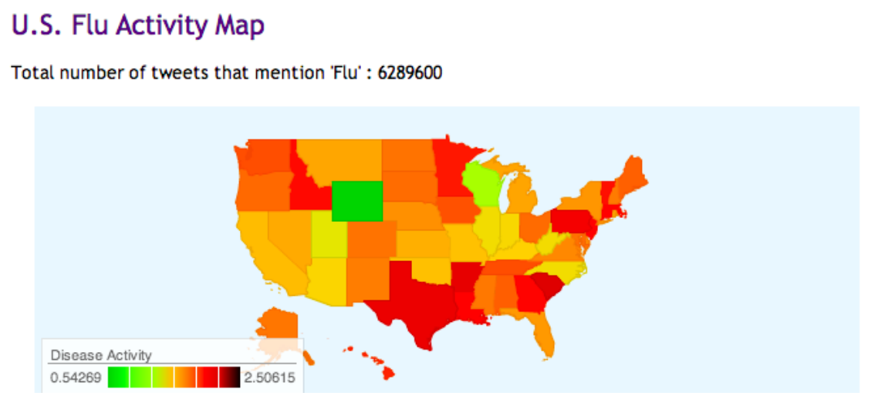
Main Subject
Ⅱ. Effect – what, ...
Geographical Analysis
<U.S. Flu Activity Map>

Slide 10
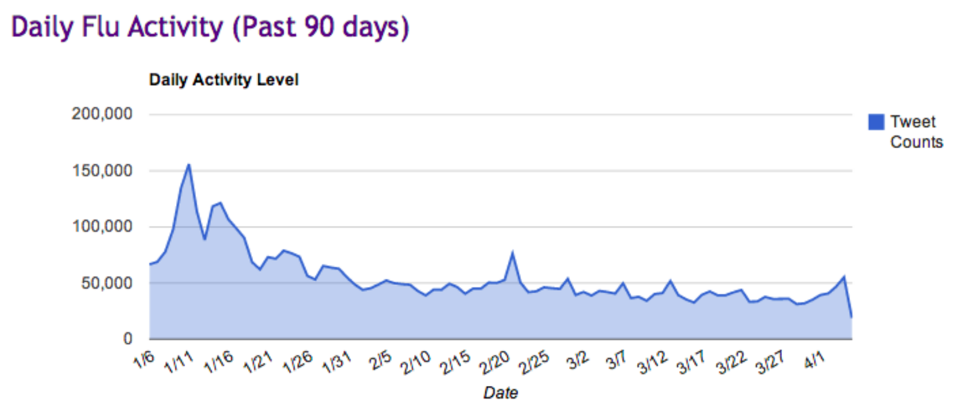
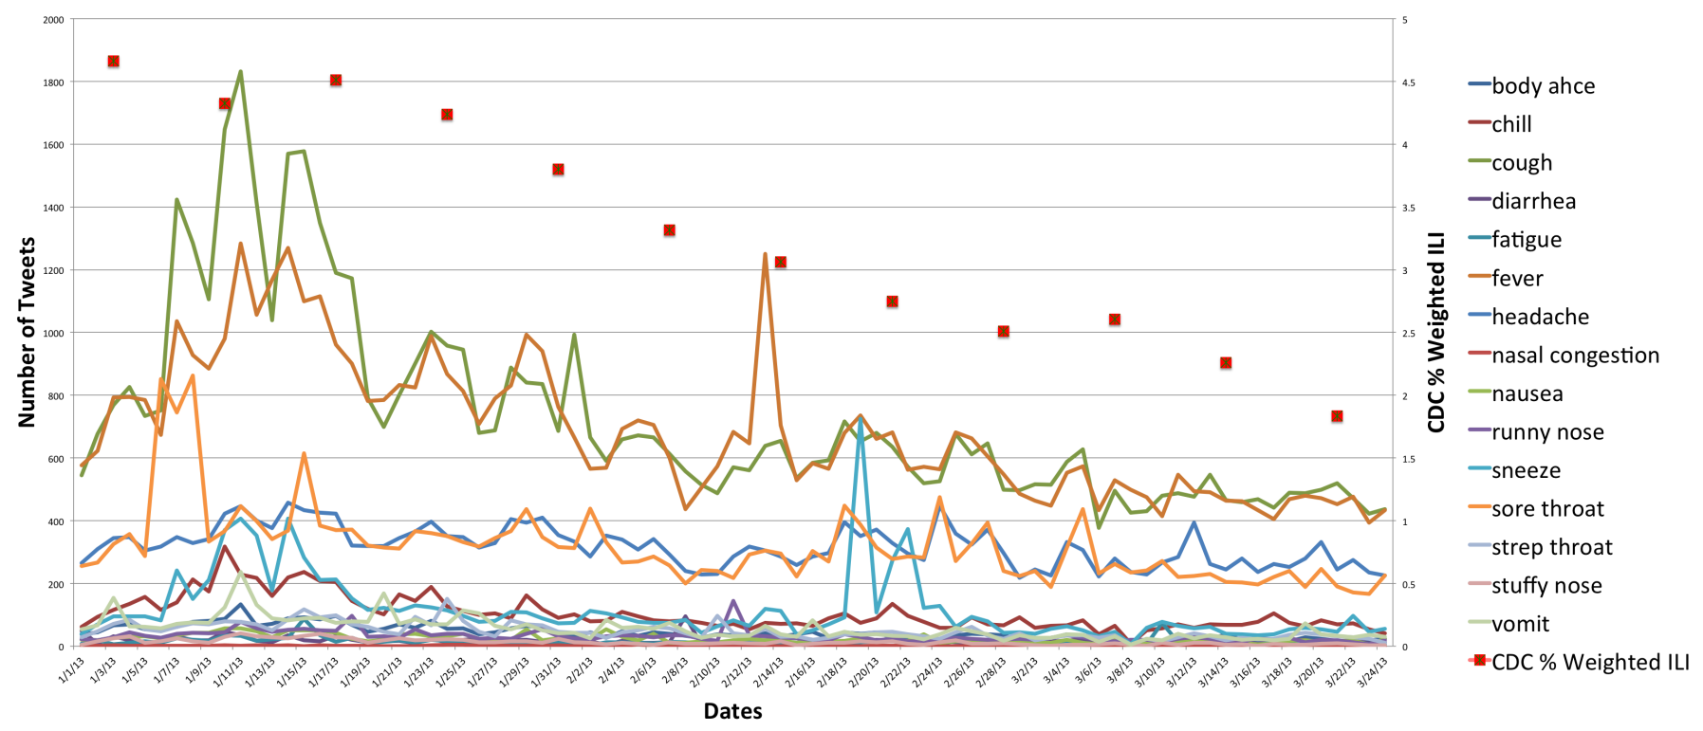
Main Subject
Ⅱ. Effect – what, ...
Temporal Analysis
<Daily Flu Activity>
<Flu’s Symptoms Timeline>

Slide 11
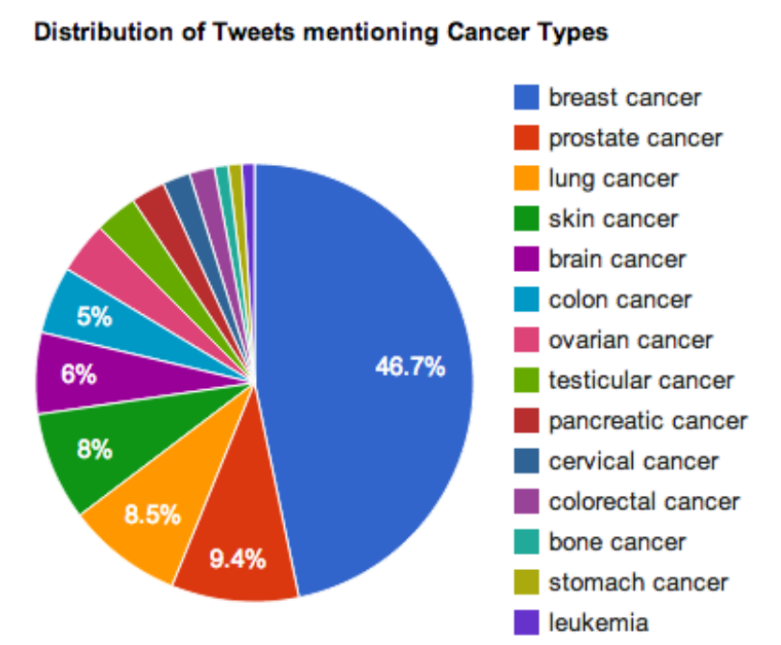
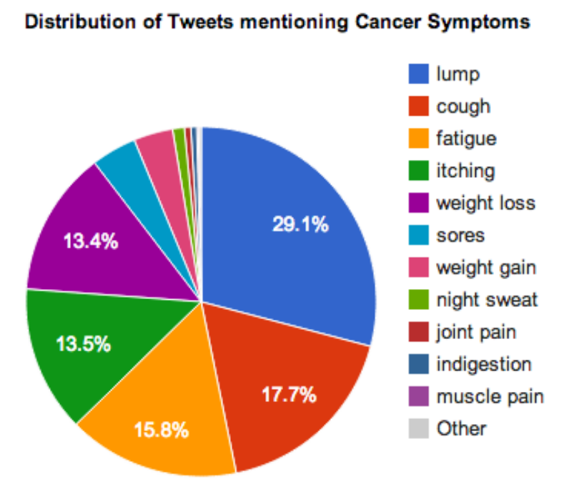
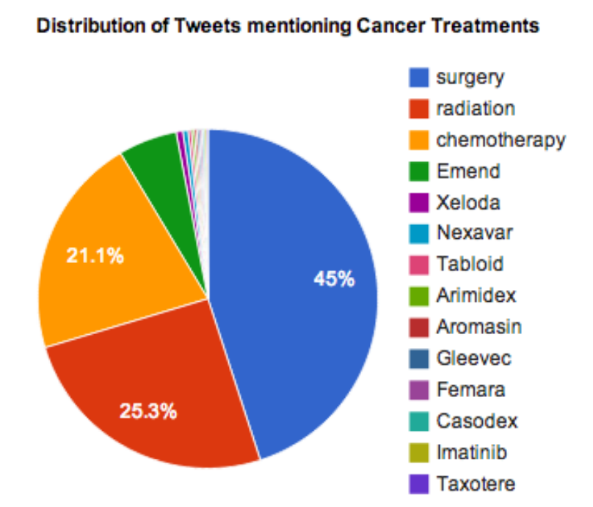
Main Subject
Ⅱ. Effect – what, ...
Text Analysis (i)
<Cancer Types>
<Cancer Symptoms>
<Cancer Treatment>

Slide 12
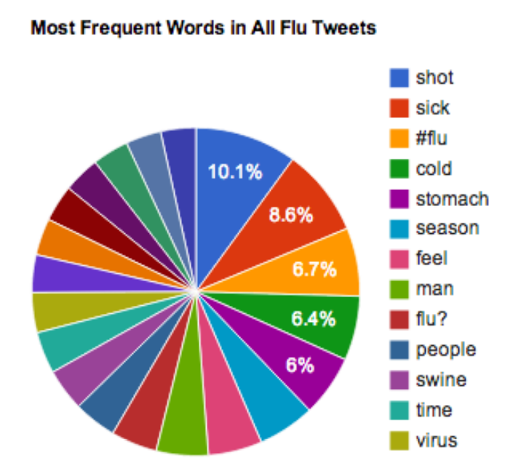
Main Subject
Ⅱ. Effect – what, ...
Text Analysis (ii)
<Most Frequent Words in Flu Tweets>

Slide 13
Conc.
Ⅰ. Result & Prospect – so, ...
This article shows…
By using a Twitter database, it is possible to map US regional disease activity levels in ‘Real-Time’.
Also discover and compare popularity of its types, symptoms, and treatments.
It can be extended easily to the other diseases to track.
Predicting disease outbreaks is expected in the future, due to its automation and quickly updating property.

